Slide 1


Agency Express
A quick guide to using the online ordering system
Training for partners

Slide 2
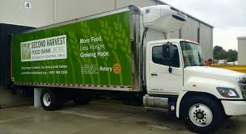
Agency Express
Ordering 101:FAQ’s
Pick up & Delivery appointments are to be scheduled with customer service
Delivery orders must be 750 lbs. minimum for each program (pantry, soup kitchen, backpack etc.) Meat, breads, pastries & retail produce is included.
Deliveries are $30.00 per program
Orders must be submitted for each program separately
All orders are subject to food bank approval

Slide 3
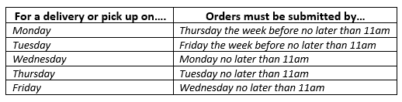
AGENCy express
You may place an order up to 7 business days before your scheduled pick up or delivery…
You must submit your order no less than 2 business
days before your scheduled pick up or delivery no later than 11am…
Any orders submitted after 11am will be processed the next business day! If for any reason you are unable to submit your order in the time allotted please call customer service to reschedule.

Slide 4

Agency express
Your Login Information
  Your Username: The first letter of your first name & your full last name in all capital letters ( example: Brad Pitt = BPITT )
  Your password will be:change12 (after logging in we recommend changing the password to something you will remember if you want to. If not you may keep the password assigned to your program)
  Program Code: The program code is a unique code that identifies from which food bank you are ordering and for what agency you are ordering.
  The program code is broken into two parts:
    Food Bank Code: 0202p
    Program Number: (This is a 6 character combo of numbers & letters which was assigned to your agency by Second Harvest)
    0202P + Your Program Number (ex. 0202PPRL000)
  You must be set up as a shopper if you want to place an order for your program. Verify your shopper status with your program director or coordinator.

Slide 5

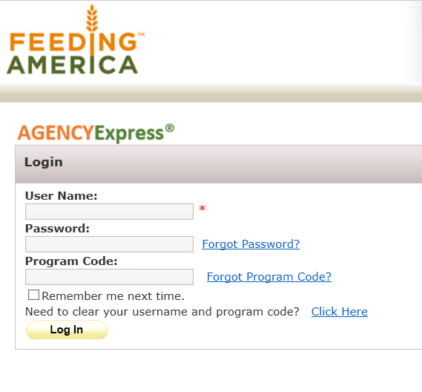
STEP 1: Logging In
Use your internet browser to access the Agency Express website
LINK HERE: https://www.agencyexpress3.org/AgencyExpress30/NewLogin.aspx
Enter your login credentials
Be sure to click the box that says “Remember Me”
Clicking remember me will save your username & password so you don’t have to enter each time you log into place an order.
Click “Log In”
The website link and all training materials are posted on our website (secondharvestfoodbank.org) under Partner Charity Zone food orders for your convenience.

Slide 6
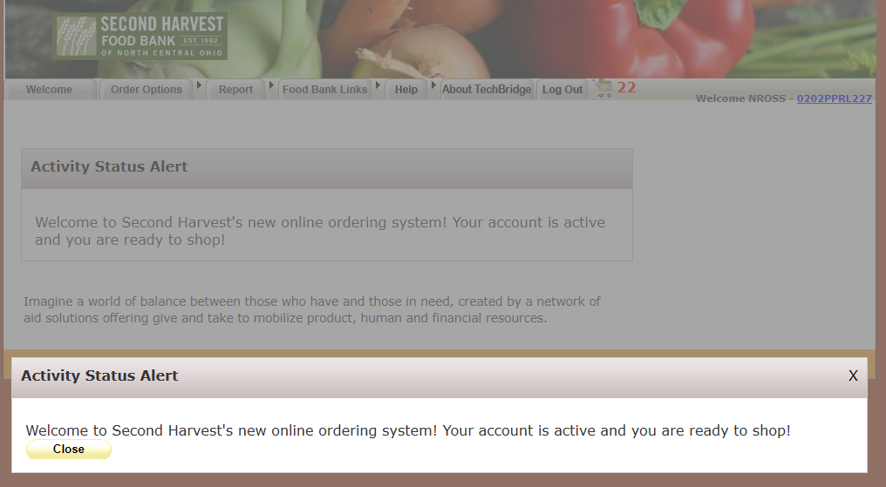
Agency Express
If we have important information such as Food Bank closings or any changes that we need to share with our partners – they will display here each time you log in! Please read carefully and click the yellow “close” button.

Slide 7
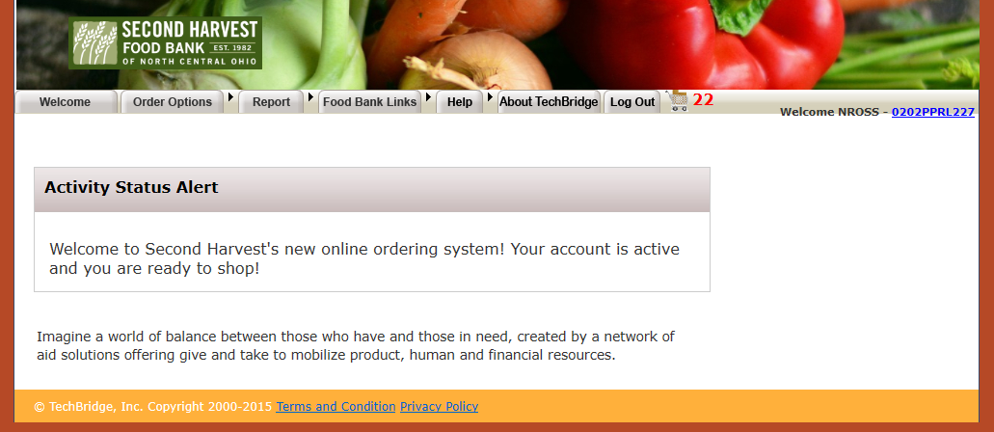
Agency express
Welcome to your Agency Express homepage

Slide 8
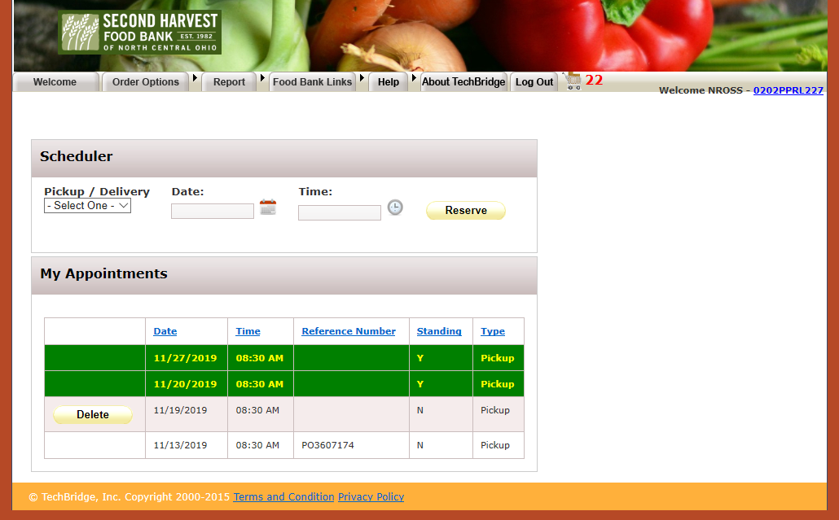
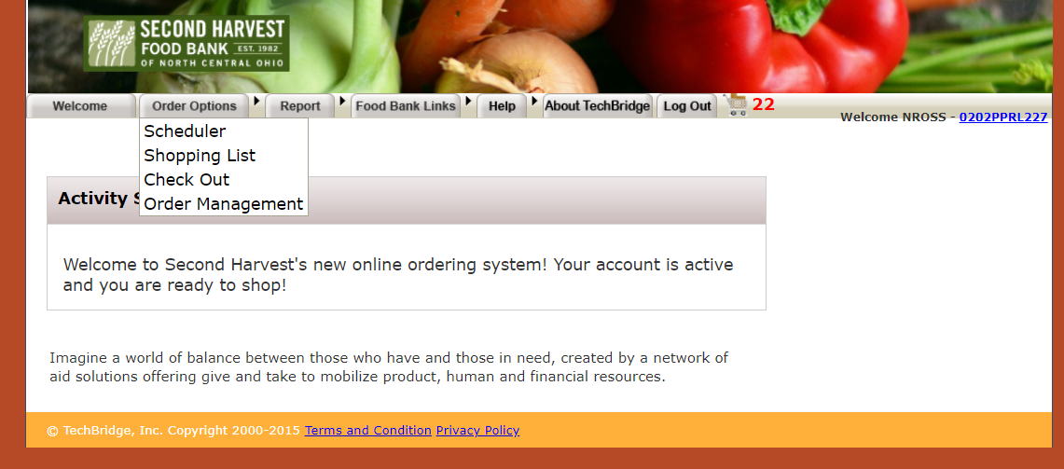
Step 2: Select Scheduler
Hover on “Order Options”& choose “Scheduler”
Check in the my appointments (The green area) section to verify the date & time of your next pick up or delivery. If you see it and it is correct proceed to your shopping list. Clean up any unwanted reservations by clicking the yellow delete button next to the appointment.
If you do NOT see your scheduled pick up or delivery in the my appointment section then you must set your scheduler.
VERIFY YOUR SCHEDULER IS SET BEFORE YOU PLACE EACH ORDER. IF IT IS NOT COMPLETE IT WILL NOT PROCESS YOUR ORDER

Slide 9
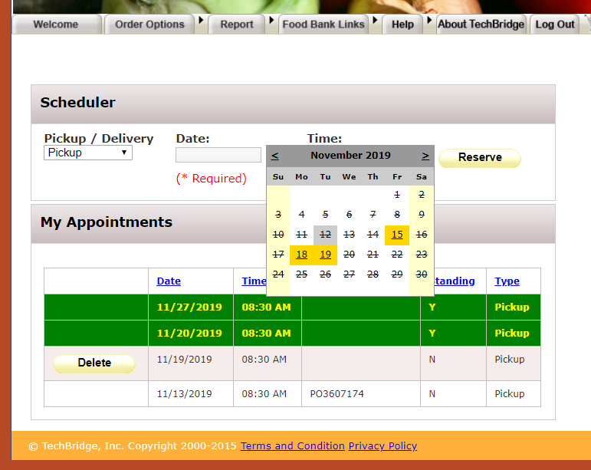
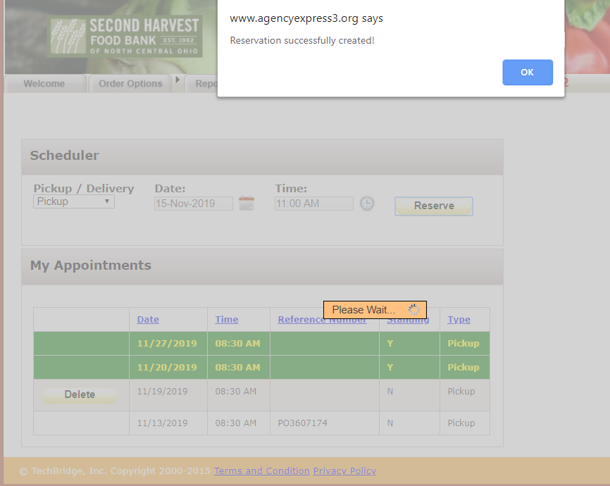
Step 2: Select Your scheduler
Select Pick up or delivery. Click on the calendar to select your date. The yellow golden blocks are dates available to YOU! Click on the clock to select a time. Click the yellow reserve button. Agency express will confirm your reservation was successfully created. Click the blue ok button & proceed to your shopping list.
If you are having trouble with your scheduler or wish to make an appointment that is not an option for you please call customer service.

Slide 10
Step 3: Build your Order
After setting your scheduler you’re ready to shop. Click on order options & then shopping list to access our most up to date inventory.
You do not have to select your scheduler if you just want to browse the shopping list or look at past orders.

Slide 11
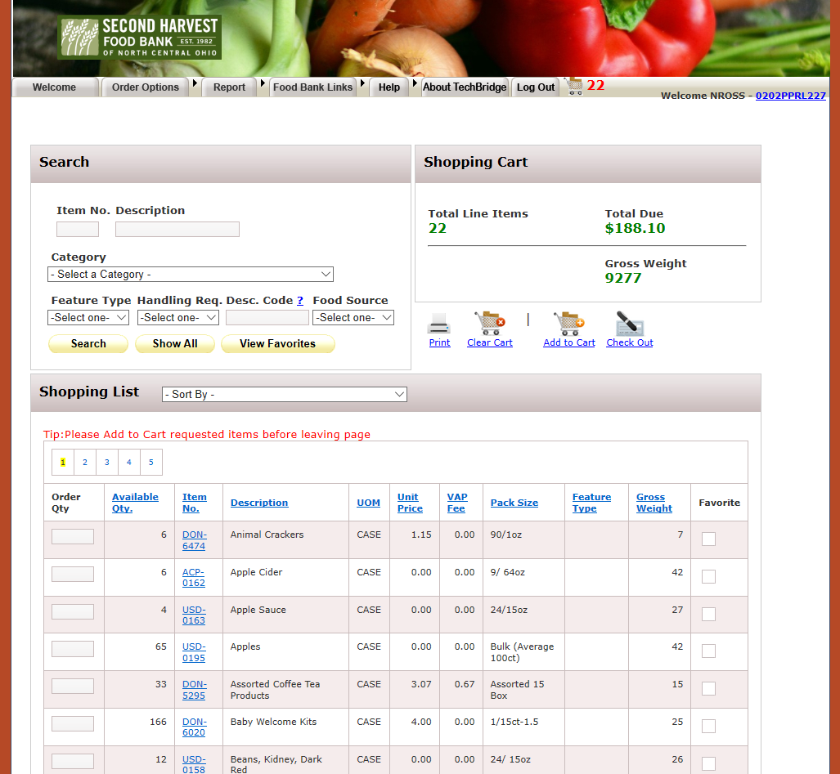
STEp 3: build your order

Slide 12
Agency express
Search our Inventory
Allows you to search our live inventory by…
Entering an item number
Entering an item description
Selecting a category
Click on “View Favorites” if you’ve marked specific items you commonly order.
Clear these fields before doing another search or sort.
HELPFUL HINTS!
Press the print button to print your order right away
Click Clear your cart to start over from the beginning
Click Add to cart to continue adding additional items
Click Check out when your are done!
Shopping Cart Box: Keeps totals of your current order for…
Total line Items: How many items are on your order
Total Due: Amount $$ due for that order (not including any delivery fees)
Gross Weight: The total poundage for your order (not including “extras”)

Slide 13
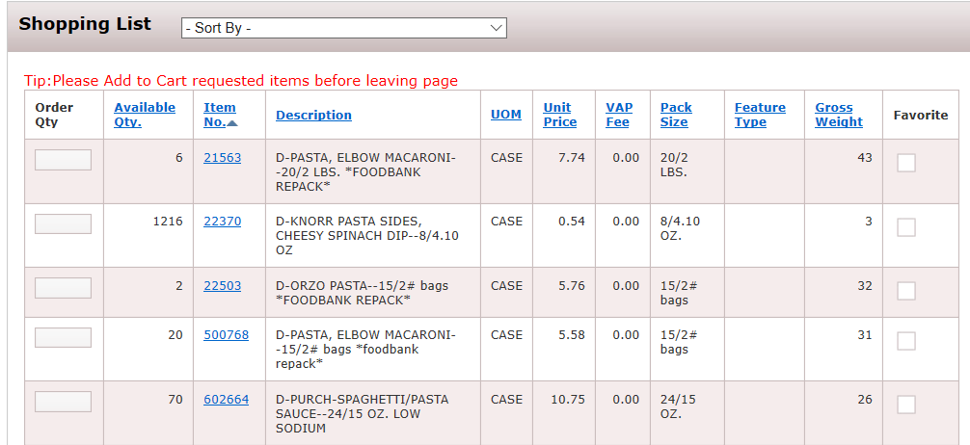
Agency express
Shopping List Elements
Click on any of the column headings to sort
Enter how many you want, based on the Unit
(see 5th column)
Click this box to save as a “favorite”
This is how many are available to YOU….
Weight per Unit
Item numbers describe product type (DON,USDA, OFP etc.)
Cost per case
How many individual items in the Unit, and their size/volume
Description gives relevant info about product
Describes the unit you’re ordering; by the case, or the pound, etc.

Slide 14
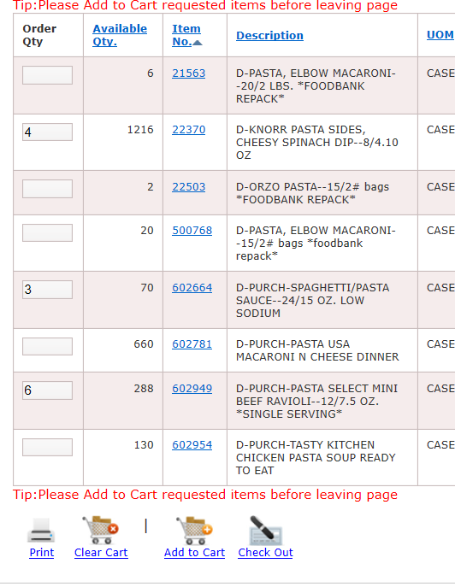
Step 3: Build your order
Go Shopping!
Enter the items and
quantities you want.
When you are done selecting items from the page you are on, click ADD TO CART.
You can add to cart after each item or after each page.
Items shown in Agency Express are “live”quanities of what we have in inventory. If something is NOT available for you to order you will NOT see it ☺
You will see a successful message after adding items to your cart correctly. If you don’t see this message try clicking it again.
You MUST click add to cart after each item or each page you enter quantities for. If you skip this and go to another page, you will lose the items you chose!

Slide 15

Agency express
Before you move to the next page of the shopping list, be sure to click
ADD TO CART
or you will lose everything you selected on that page!

Slide 16
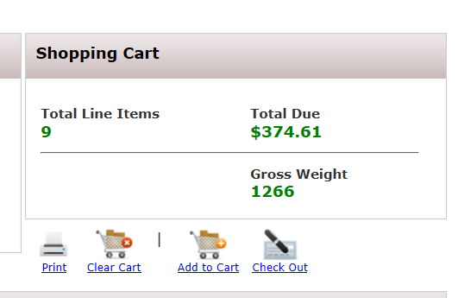
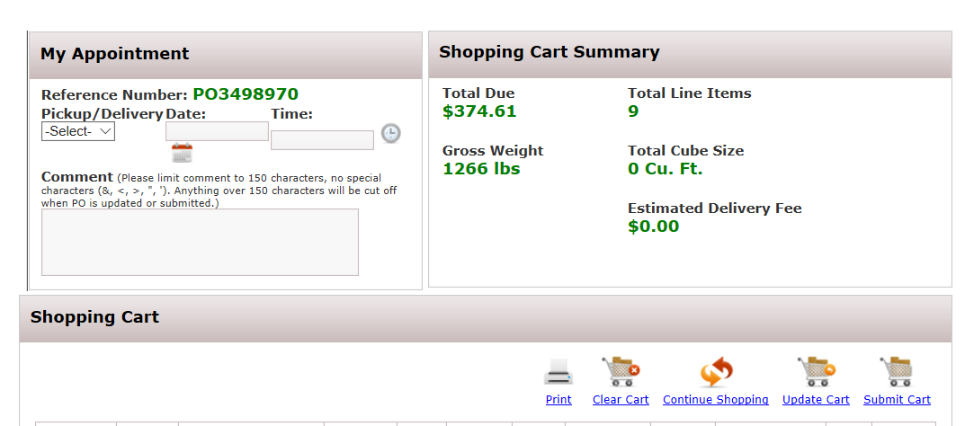
Step 5: Finalize your order
When you are done adding things to your cart, go to the top right corner area and click on check out
This screen will come up – (explained on next page)

Slide 17
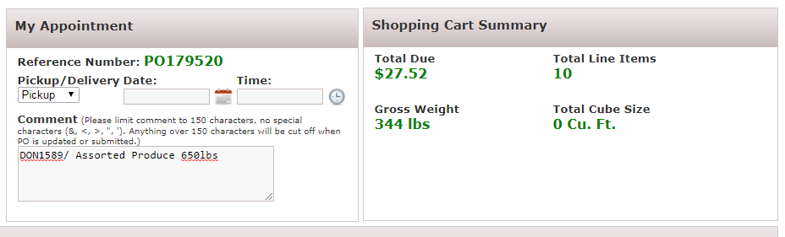
Step 5: Finalize your order
Finalizing your order elements
Find and select your appointment type, date and time: THIS DATE & TIME MUST MATCH THE DATE & TIME OF THE SCHEDULER YOU SET AT THE BEGINNING!
Weight of your order (not including Request items). Must be at least 750 lbs. for a delivery.
This is the cost of your order. (does not include delivery fee or any charges for meat)
Enter your “extra” items and amounts you want. Use the format shown, which is the item number followed by backslash , then the item description and then the pounds wanted. (This should be the LAST thing you do before submitting the cart. If you do something else before submitting you will lose these notes!)
Shows how many items are on your order
TIP: Some people find it helpful to copy this info and paste into another document for short-term safekeeping.

Slide 18
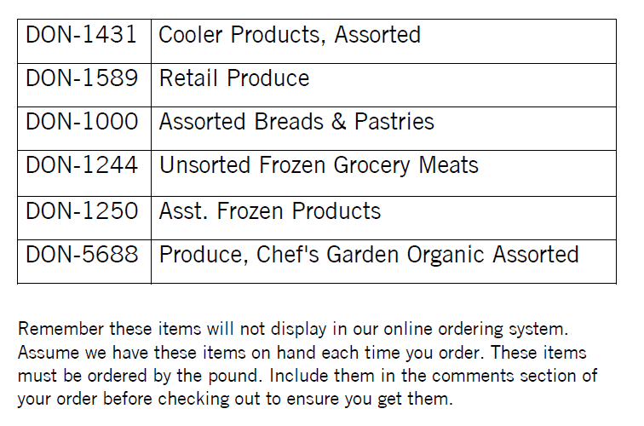
Step 5: Finalize your order
Ordering the “Extra’s”
Please keep these item numbers & description titles on hand for you to reference each time you place an order. You will not see these items in Agency Express. You should assume we have all items available at the time you place your order. There will be no way for you to see how much of the “extras” we have in inventory.
Don’t forget! When ordering unsorted frozen grocery meat keep in mind it is .16cent per pound.
You will see the full total of your order on your next invoice.
Enter your “extra” items & amounts you want. Use the format shown, which is the item number followed by a backslash, then the item description and then the pounds wanted. (This should be the LAST thing you do before submitting the cart. If you do something else before submitting you will lose these notes!)

Slide 19
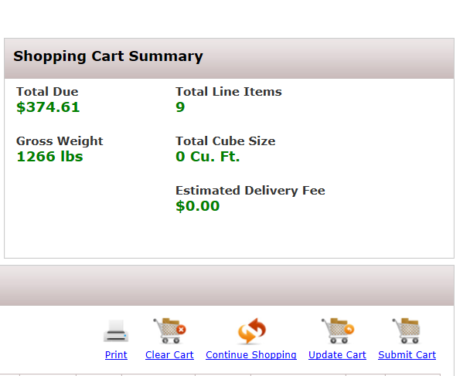
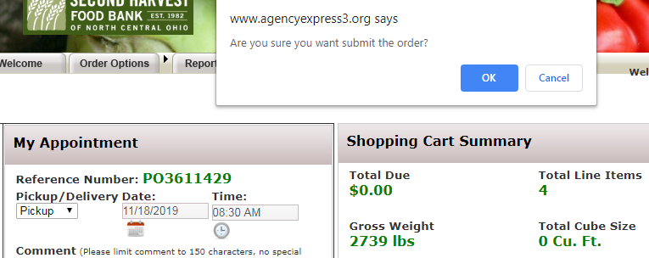
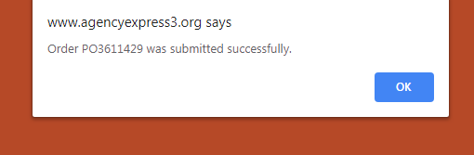
Step 6: Submit your order
When you are satisfied that everything is correct, click on “Submit Cart”.
If you close the order before submitting your cart you may lose some of those items to other shoppers.
You may add items to your cart over a period of time before placing your order, however this does not hold items for you until you actually submit your cart.
An order number will be assigned and a printable list of all your items will come up.
You will receive an email confirmation of what items will be on your order from Second Harvest.
SUBMIT YOUR ORDER HERE

Slide 20
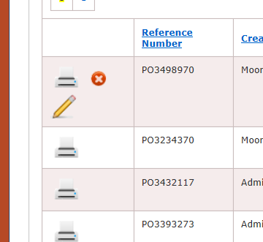
Step 7 (optional) : Edit your order
You can re-open and then change your order while still in the “ordering window” time frame.
Hover on the Order Options tab and click on Order Management.
When your order shows a little pencil, you can click on that and it will reopen. (After first submitting, it
takes a little while for the pencil
to appear.)
Once you’ve made changes, be sure to SUBMIT YOUR CART again.
If there is no little pencil, it is either too soon or too late to make any changes to the order.

Slide 21
Agency Express
The extra Bells & whistles

Slide 22
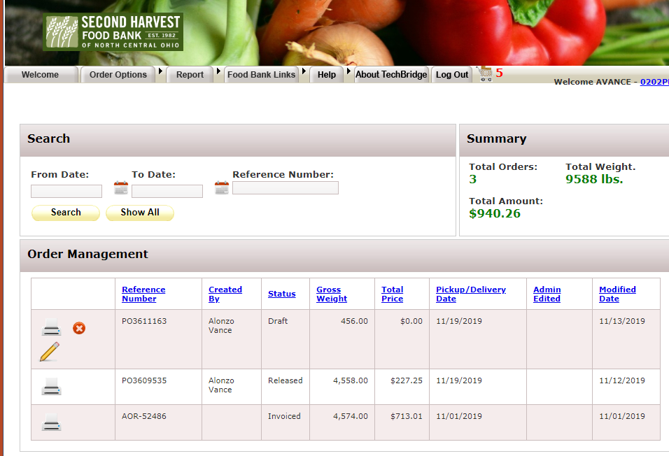
Agency Express Extra’s: Order Management
Agency Express will store and save all past orders for your convenience. Click on the white printer button to view and or print the order. The summary box is a cumulative total of all orders, weight and $ amount place through Agency Express by your program.
You can see who created the order, status, gross weight, total price, pickup/delivery date, modified date.
Tip: This can be helpful to use when presenting to a board or applying for a grant. Easily access your poundage with Agency Express

Slide 23
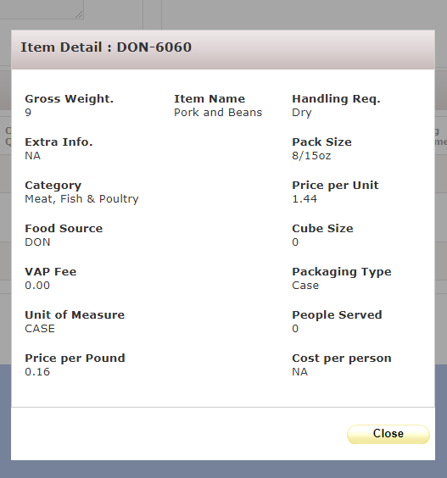
Agency express extras: order management
By clicking the Item number in your shopping list you can see a bit more detail about that specific item.

Slide 24
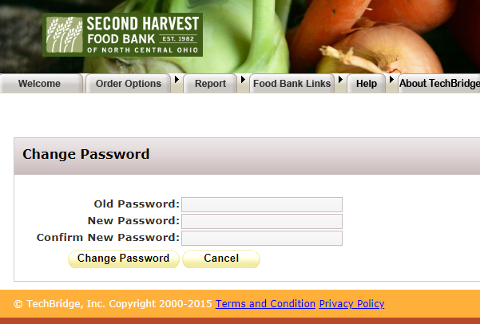
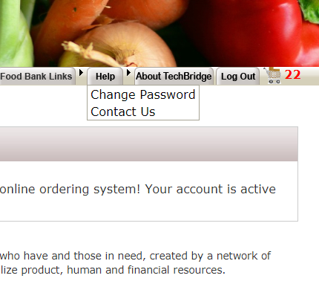
Agency express Extra’s: Your password
Change your password to something you will remember! You can change your password at any time. It is important to keep this information safe after it is changed from what we set for you we no longer have control. Agency Express will prompt you through the process and give a successful message when the password is changed correctly.

Slide 25
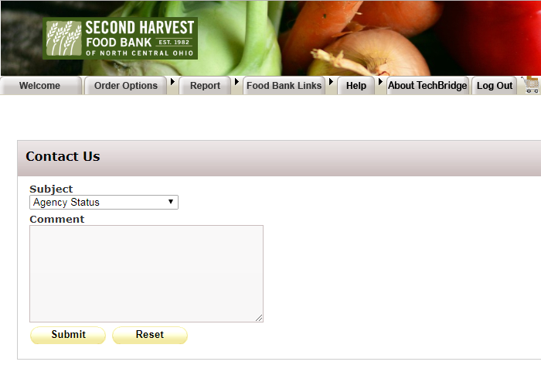
Agency express Extra’s: Contact us
Submit a contact us ticket! This is another way to contact Second Harvest staff if you are having issues or have questions about Agency Express.

Slide 26
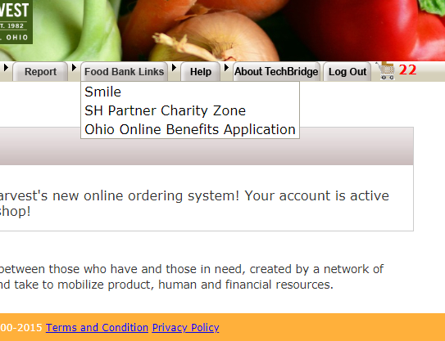
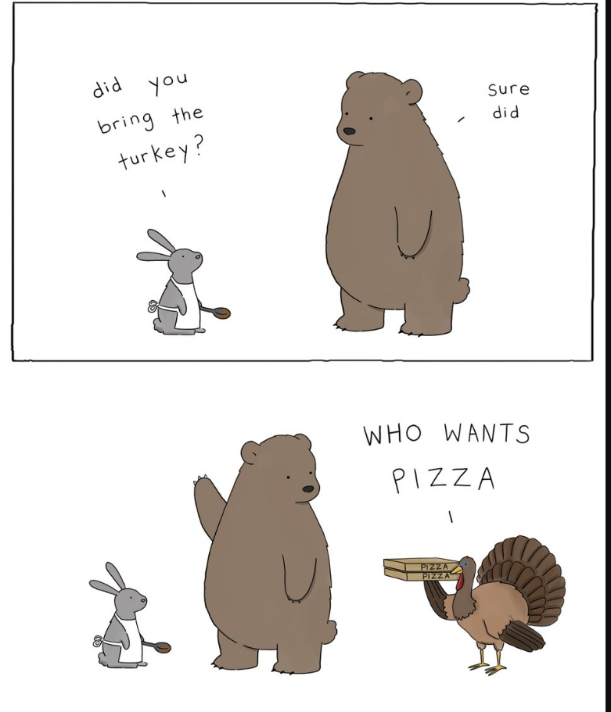
Agency express Extra’s: Food Bank Links
Food Bank Links is a place to find resources that may help someone.
If you are ever feeling down click the smile button. (Yes it really will make you smile) ☺

Slide 27
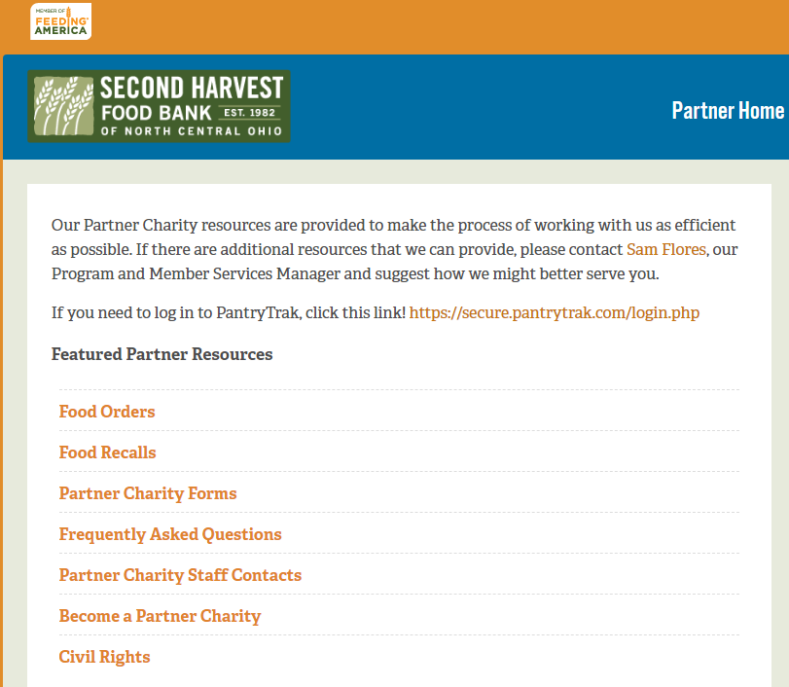
Agency express Extra’s: Food Bank Links
Food Bank Links is a place to find resources that may help someone.
Click the partner charity zone to access our website- where you will be able to access featured partner resources.

Slide 28
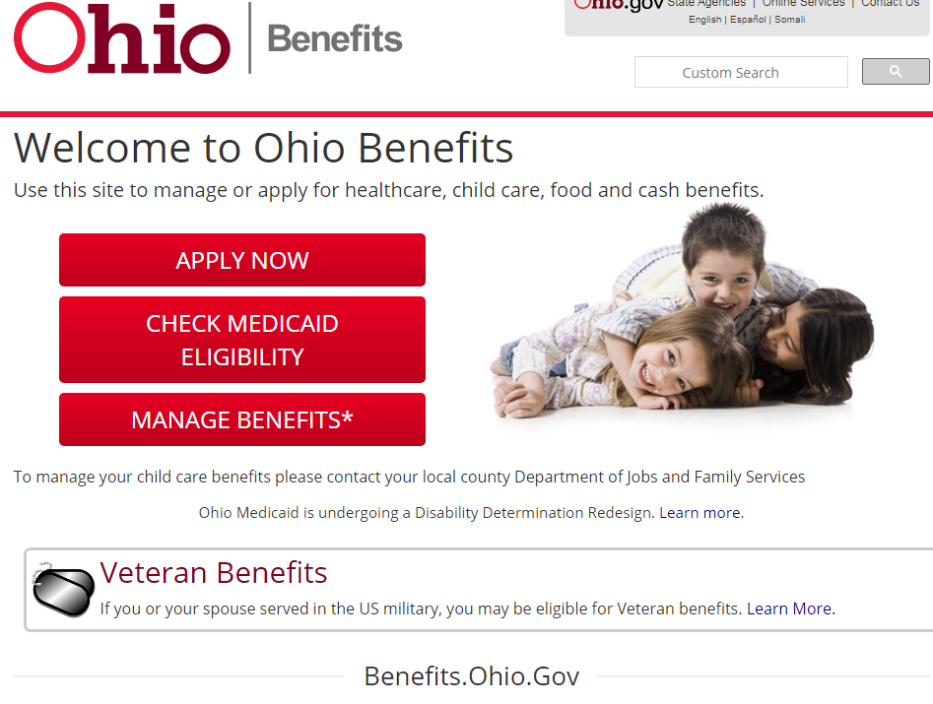
Agency express Extra’s: Food Bank Links
Food Bank Links is a place to find resources that may help someone.
Click the Ohio Online Benefits Application to help a community member apply for SNAP , Medicaid or manage benefits.

Slide 29


Questions?
Contact Second Harvest Staff with questions
Food Order Help
  Dawn Kinsley, customer service coordinator : 440-444-0709 dkinsley@secondharvestfoodbank.org
Agency Express Website & Training
  Brittney Hopkins, Program & Education Coordinator : 440-960-2316 bhopkins@secondharvestfoodbank.org
Accounts Payable Help
  Tami Kluding, Business Services Manager :440-444-0698 Tkluding@secondharvestfoodbank.org
Stats /Compliance/Programs Hold
  Sarah Horan, Compliance Coordinator :440-444-0712 shoran@secondharvestfoodbank.org
General Questions
  Samantha Flores, Program & Member Services Manager: 440-444-0695 sflores@secondharvestfoodbank.org

Slide 30

Agency Express
THANK YOU

